Slide 1
Birthday Attacks on Various Hash Functions
By Dane Zieman

Slide 2
Overview
The purpose of this experiment is to examine how traits such as preimage resistance or collision resistance affect hash functions in practice.
various hash functions were subjected to birthday attacks and their performance was measured.
The hash functions used in this project were MD5 and two simple hash functions invented for this experiment.
Additionally, these hash functions were compared to the random oracle model.

Slide 3
Experiment Design
Design a program to check perform attacks on hash functions
Design two simple hash functions to test with this experiment
These hash functions should perform well against random attacks
Choose types of attacks to test hash functions

Slide 4
Hash Collision Detection Program
Designed a program to test various attacks on hash functions
Chooses an input value based off type of atttack
Stores outputs in a hashset, and records how many hashes it takes to get a collision
Code is available on my github (account: Dane8373)

Slide 5
Two Simple Hash Functions
Idea: Have one function be linear of the form a*x + b mod n
Have the other be a quadratic function of the form a * x² mod n
Need constraints to ensure good resistance to random attacks

Slide 6
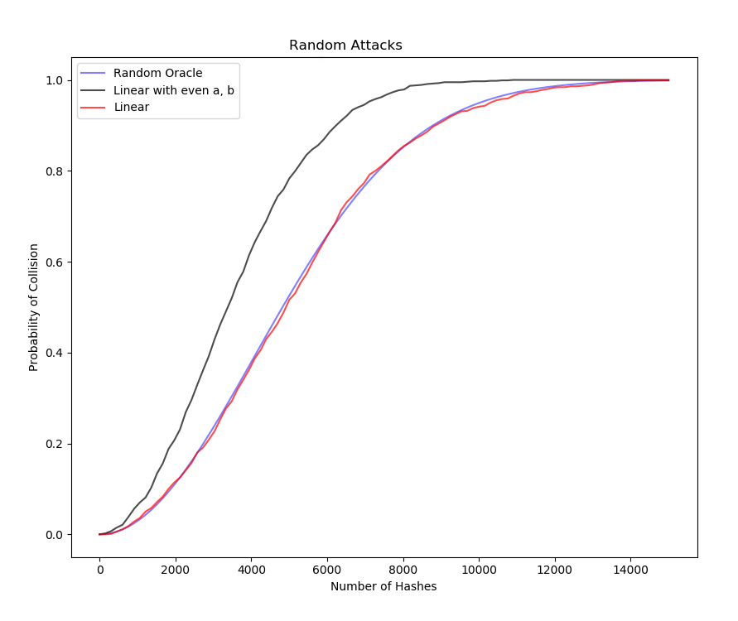
Designing the Linear Hash Function
If a is even, then a*x + b is either always odd or always even
This halves the output space, not desirable
Final Linear function:
a*x + b where a is odd

Slide 7
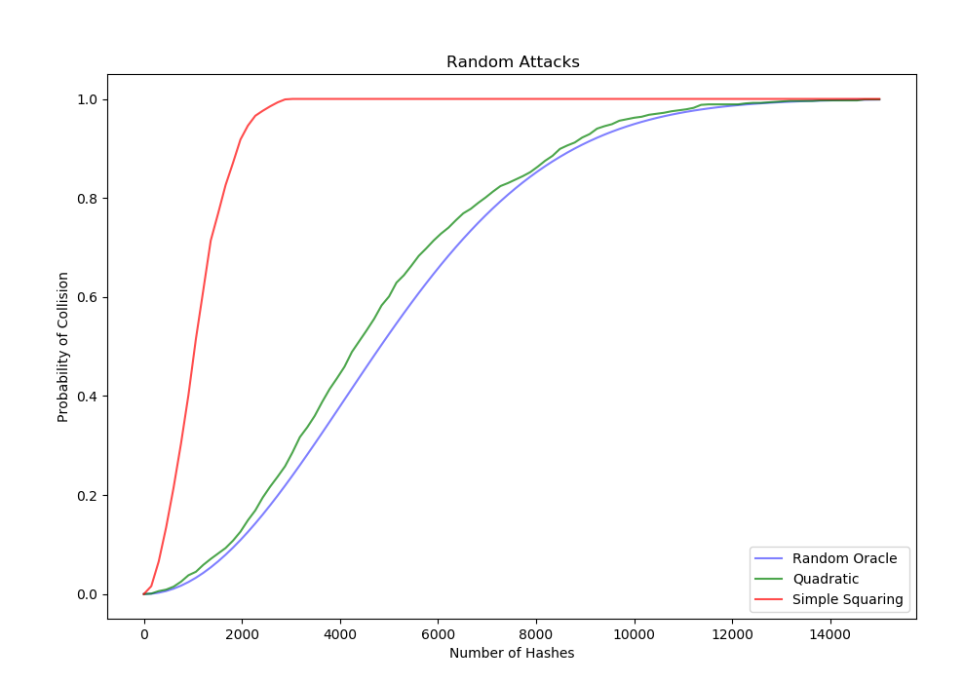
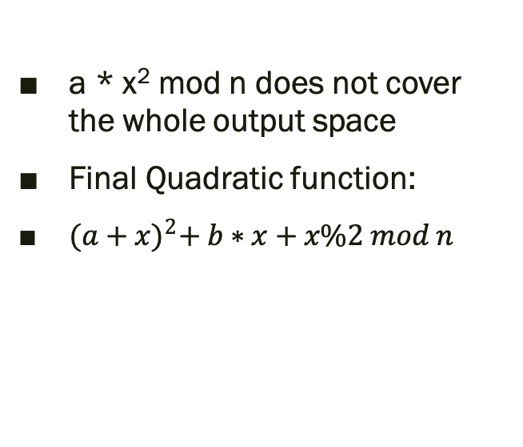
Designing the Quadratic Hash Function
a * x² mod n does not cover the whole output space
Final Quadratic function:
${(a+x)}^{2}+ b∗x+x\%2 mod n$

Slide 8
Types of Attacks
Random Attack
Repeated Multiplication by 2 attack
Evens only attack
Additive probing
Square of old Hash
All tests run with 64 bit input and 24 bit output, with 1000 tests per attack per hash function

Slide 9
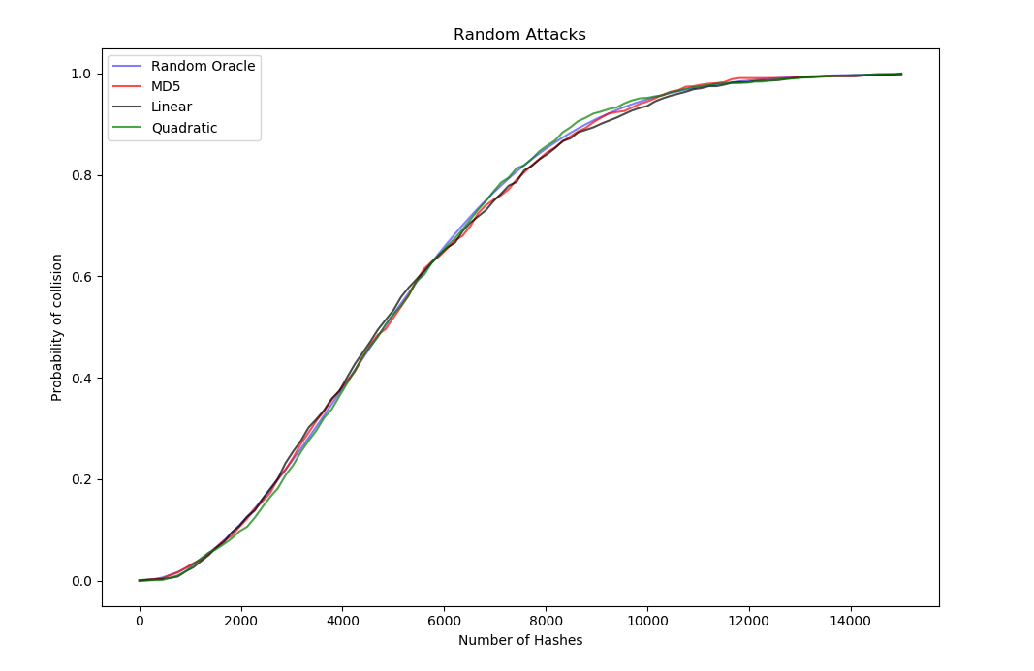
Random Attacks

Slide 10
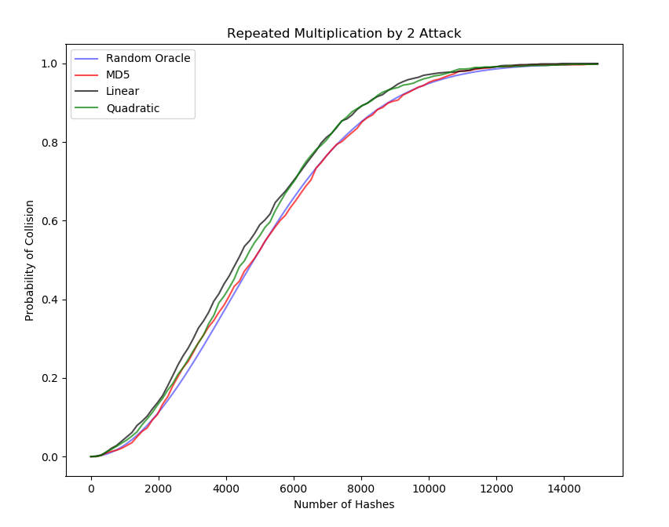
Repeated Multiplication by Two Attacks

Slide 11
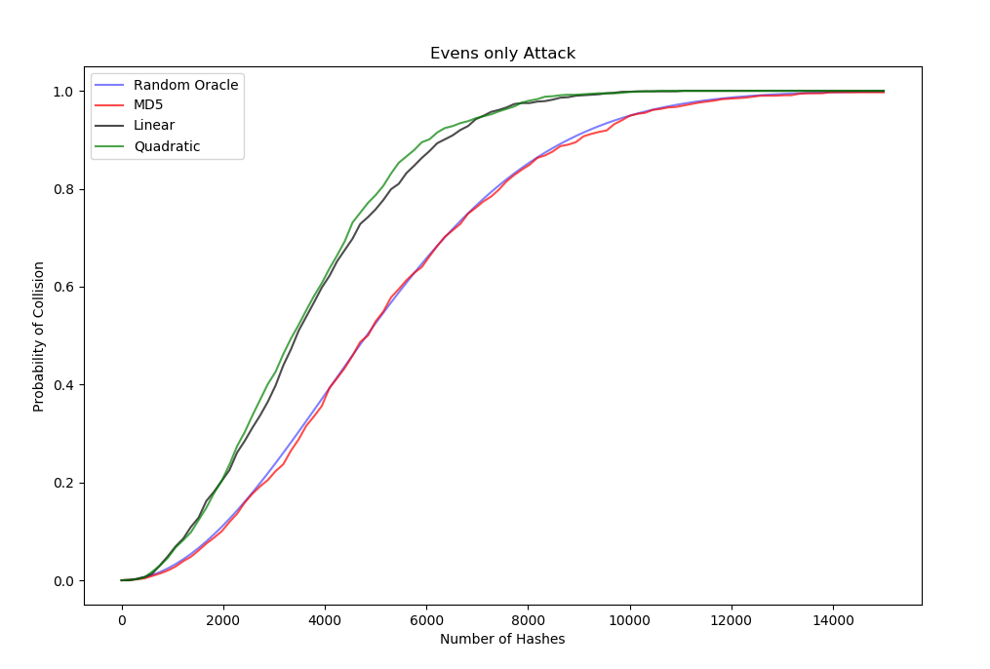
Evens Only Attacks

Slide 12
Additive Probing
No Collision could be found for quadratic or linear hash function under additive probing
MD5 performed similar to how it did for random attacks

Slide 13
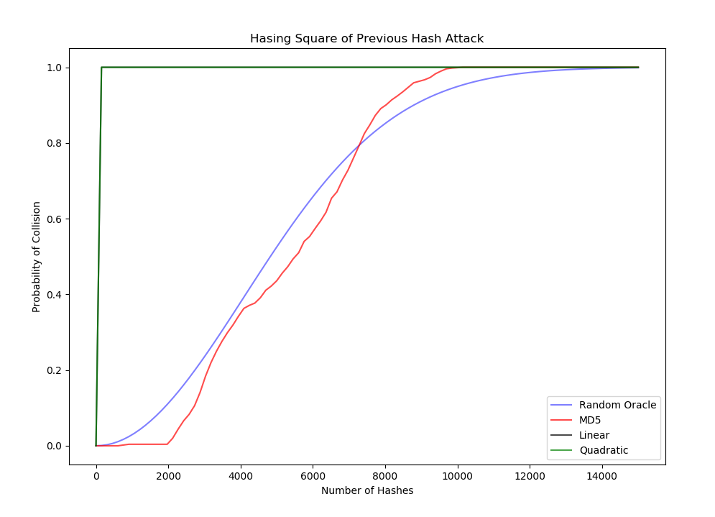
Square of Previous Hash Attacks

Slide 14
Conclusions
Without sufficient preimage resistance and collision resistance, hash functions are vulnerable to certain attacks
Even attacks that do not yield collisions can instead leak information about the type of hash function

